Slide 1


School of Computing and Information Sciences Florida International University
Advanced software Engineering, Fall 2016
LegalWise 3.0
Students | Michel Angelo Roger Renato Almeida Florida International University
Product Owner | Jaime Borras CTO at GeoToll
Instructor | Masoud Sadjadi Florida International University
December 2th, 2016
Notes:
Greet your audience, thank them for attending your presentation, introduce yourself, introduce your project, introduce your team members, and quickly indicate what each of you did in a high-level manner, and put more emphasis on your part/contribution.

Slide 2
Problem
Legal professionals, while working on current cases, perform research to find out how previous courts have decided on cases with similar fact patterns.
Some problem that arise with that approach
Manual searching, time consuming.
Decentralize place to retrieve documentation, increase cost.
Volume vs. time to research, ineffective search.
Ineffective
Inefficient
Expensive
Notes:
HERE: Introduce the problem that the whole project tackles
NEXT TO NEXT SLIDE: and stay focused on the parts that you have been working.
NEXT SILDE: Indicate if there is an existing previous system, enumerate its problems/limitations, etc.

Slide 3
Solution
LegalWise, a user friendly system for lawyers and law associates that allows them focus on what really matters, the customer case.
Features of LegalWise,
Easy to use search engine, with effective results.
Centralized place to retrieve documents, at a lower cost.
Machine Learning algorithm, high efficient search→ lower time of searching
Notes:
HERE: Introduce the problem that the whole project tackles
NEXT TO NEXT SLIDE: and stay focused on the parts that you have been working.
NEXT SILDE: Indicate if there is an existing previous system, enumerate its problems/limitations, etc.

Slide 4
LegalWise 3.0
Continue adding new features and enhancement of the previous work.
Principal focus,
Train machine learning algorithm
Effective storage and conversion of documents
Search for a new ways to create knowledge base
Additional Features,
Register a guest user on the application
Reset user password
Notes:
HERE: Introduce the problem that the whole project tackles
NEXT TO NEXT SLIDE: and stay focused on the parts that you have been working.
NEXT SILDE: Indicate if there is an existing previous system, enumerate its problems/limitations, etc.

Slide 5
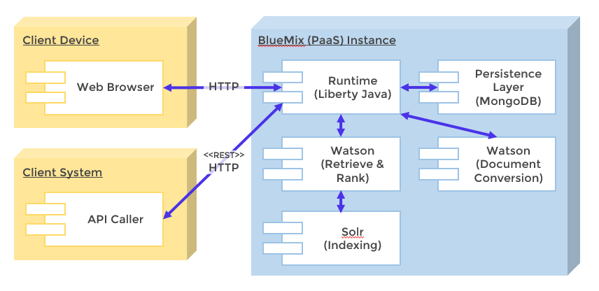
System Design
Notes:
5. System design:
5.1. System decomposition; identify the architecture patterns used (one slide).
5.2. System deployment – h/w and s/w requirements (one slide).
5.3. Persistent data design (one slide).
5.4. Security/Privacy (one slide).

Slide 6
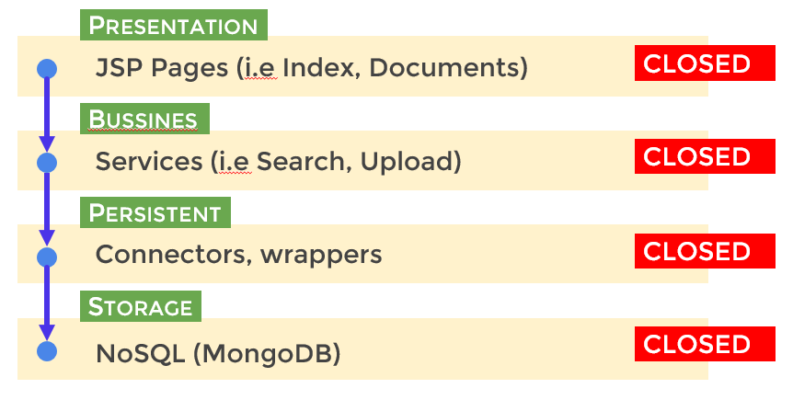
System Architecture
All layers in the system are closed: Each layer can only access the layer right next to it in the order.
Notes:
5. System design:
5.1. System decomposition; identify the architecture patterns used (one slide).
5.2. System deployment – h/w and s/w requirements (one slide).
5.3. Persistent data design (one slide).
5.4. Security/Privacy (one slide).

Slide 7
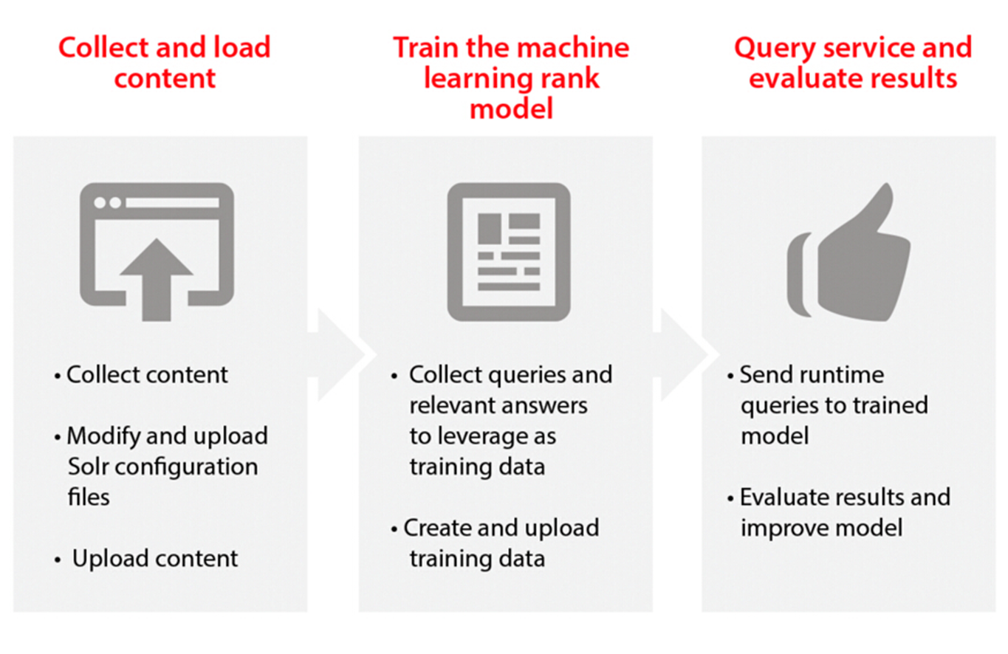
How does AI components work?
Watson Services from IBM Bluemix, figure obtain from their website
Notes:
5. System design:
5.1. System decomposition; identify the architecture patterns used (one slide).
5.2. System deployment – h/w and s/w requirements (one slide).
5.3. Persistent data design (one slide).
5.4. Security/Privacy (one slide).

Slide 8
Ask a legal question “?”
Notes:
4. Requirements:
4.1. User stories implemented (one or more slides).
4.2. UML use cases and the use case diagram for the implemented use cases (one or more slides).
4.3. UML sequence diagrams for the implemented use cases.

Slide 9
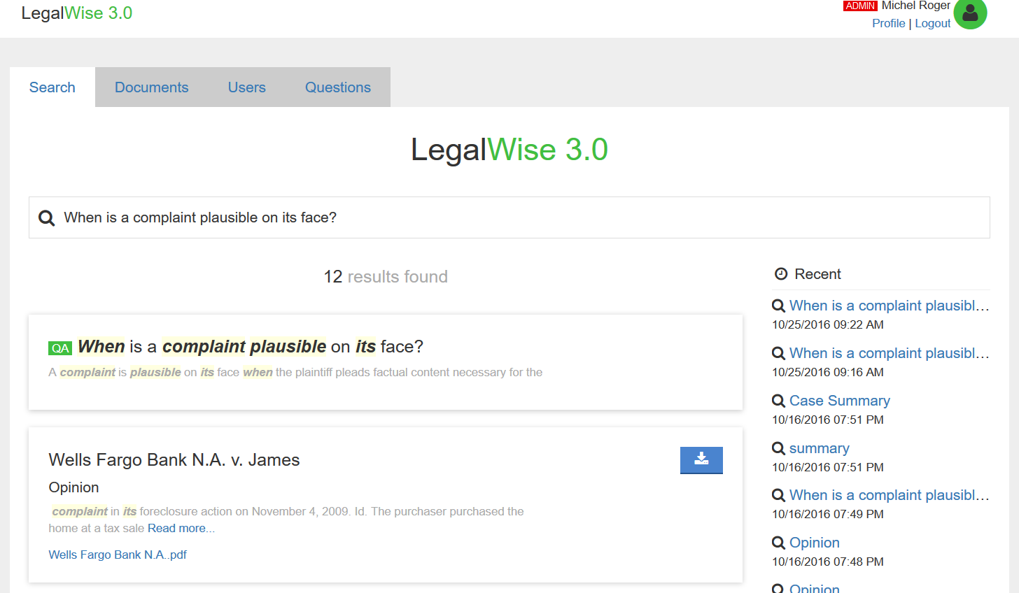
Ask a legal question “?”
Notes:
4. Requirements:
4.1. User stories implemented (one or more slides).
4.2. UML use cases and the use case diagram for the implemented use cases (one or more slides).
4.3. UML sequence diagrams for the implemented use cases.

Slide 10
Different Storage Layer
Why is there a need for a different storage layer other than SQL relational database?
Principal focus of the application
Documents are subdivided in different parts, hard to maintain and retrieve from a relation database.
Easy training of the system; current system is cumbersome without a place to reference label data at once.
Cost associated and scalability of the application
Additional Features,
Short time to market new features, improve agility, and lower the cost.
Schema design, focus on what really matter, quick and effective responses of legal questions.
Notes:
4. Requirements:
4.1. User stories implemented (one or more slides).
4.2. UML use cases and the use case diagram for the implemented use cases (one or more slides).
4.3. UML sequence diagrams for the implemented use cases.

Slide 11
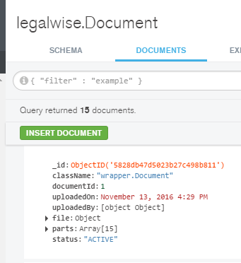
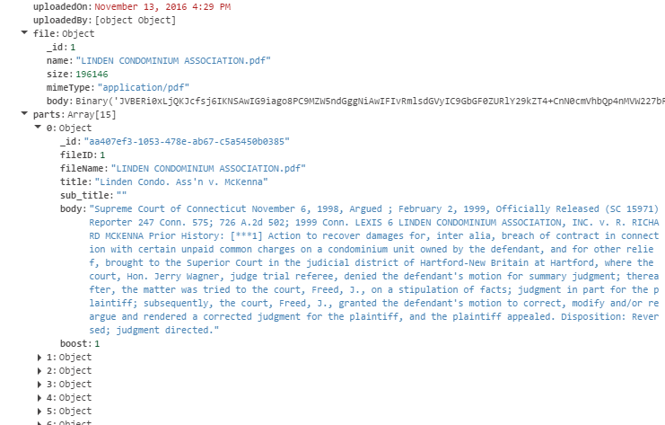
Different Storage Layer
MongoDB as a proposed solution
Whole Document with binary data and parts
Detail View of one Documents
Notes:
4. Requirements:
4.1. User stories implemented (one or more slides).
4.2. UML use cases and the use case diagram for the implemented use cases (one or more slides).
4.3. UML sequence diagrams for the implemented use cases.

Slide 12
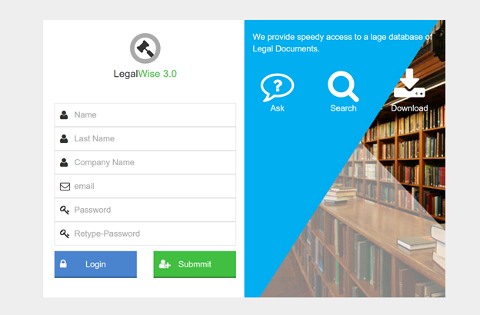
User Interface Design
Notes:
4. Requirements:
4.1. User stories implemented (one or more slides).
4.2. UML use cases and the use case diagram for the implemented use cases (one or more slides).
4.3. UML sequence diagrams for the implemented use cases.

Slide 13
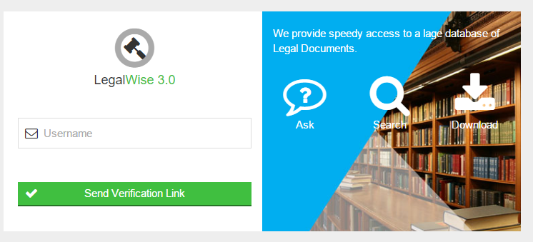
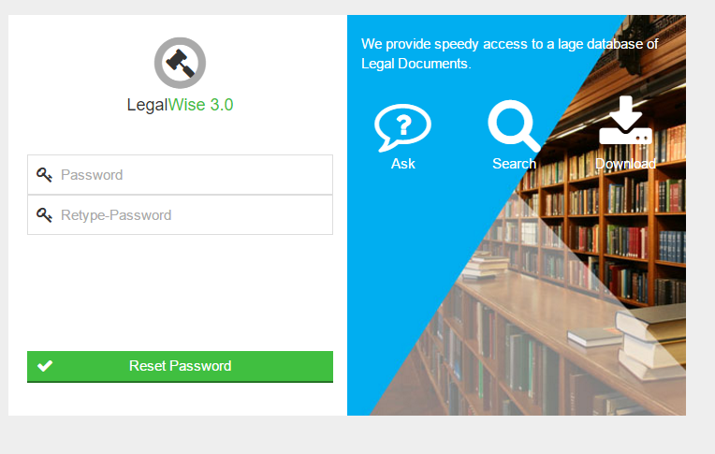
User Interface Design
Forgot Password page allows users to reset their password by inputting their valid username.
Notes:
First screenshot: System send verification link and in the back end the system verifies if user is registesred or not in DB. Then creates hash code encrypted in the link and sends email tot the registered user. Once email received, user will be able to reset their password by clicking on the linlk

Slide 14
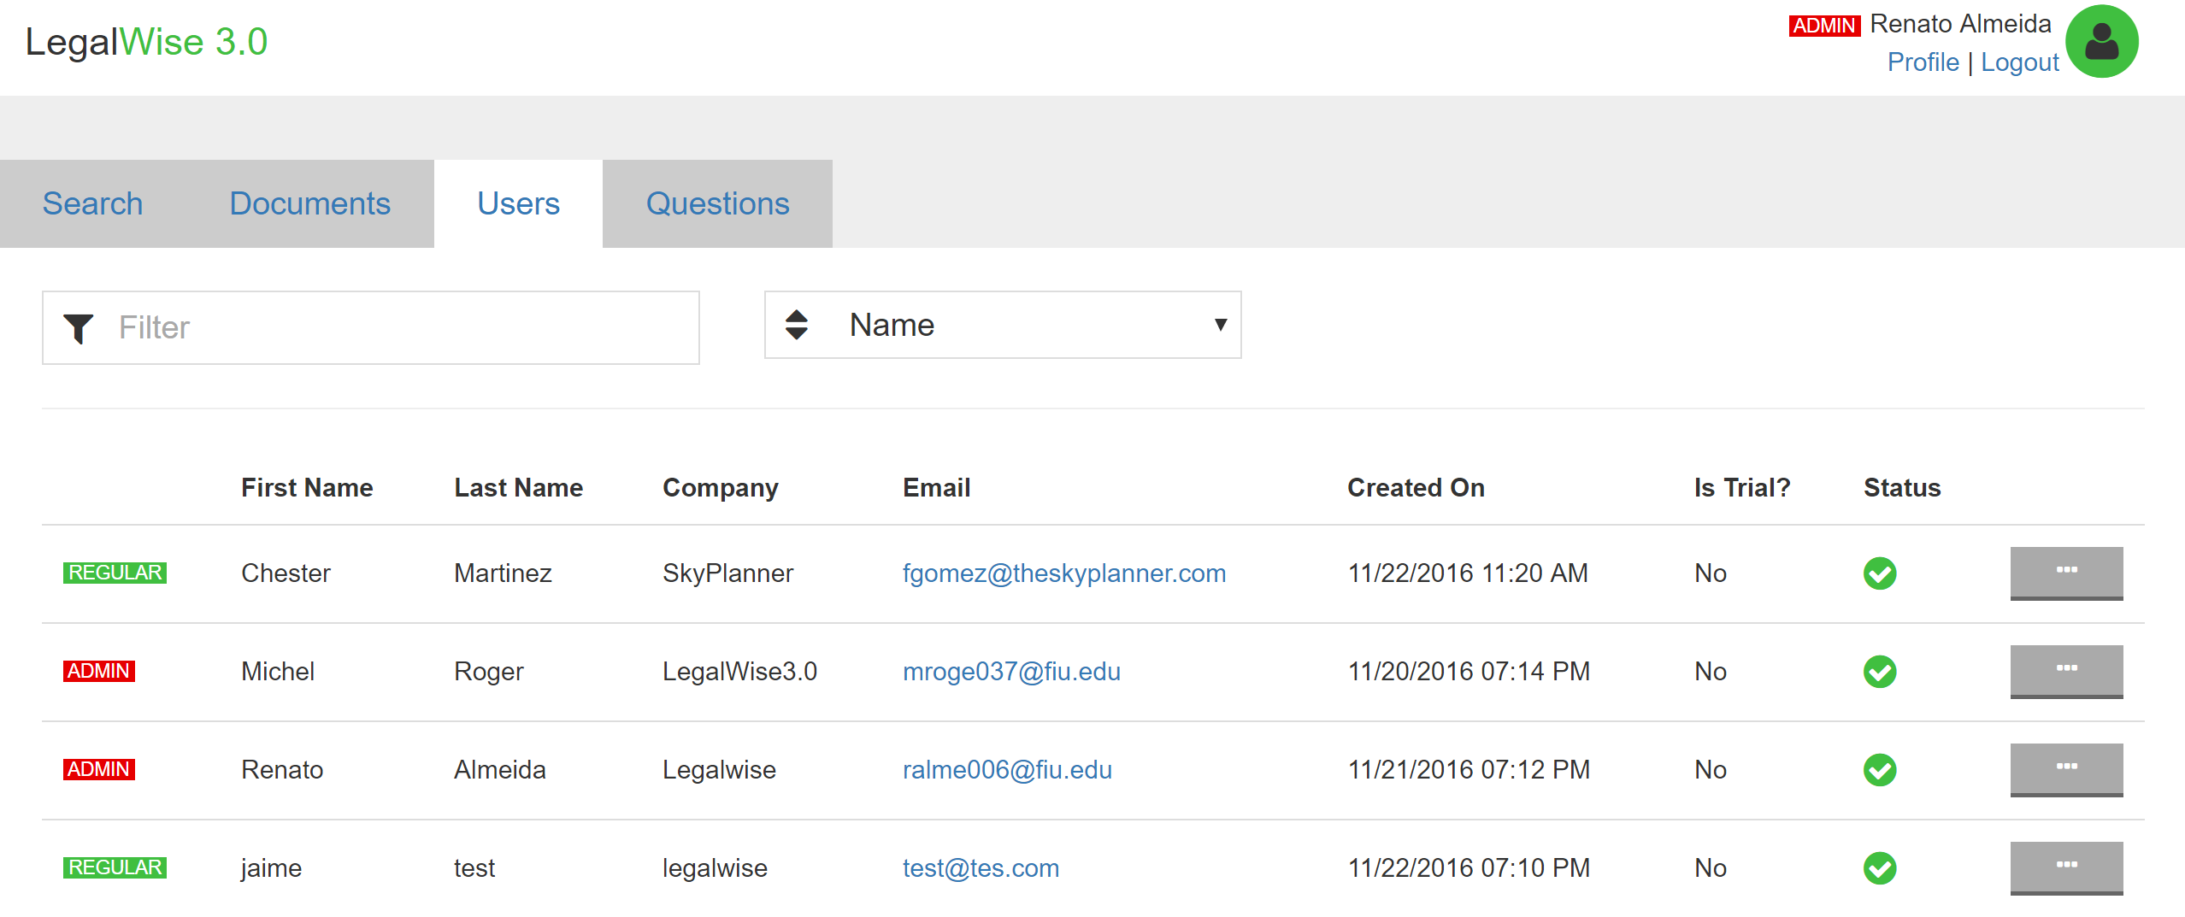
User Interface Design
Notes:
4. Requirements:
4.1. User stories implemented (one or more slides).
4.2. UML use cases and the use case diagram for the implemented use cases (one or more slides).
4.3. UML sequence diagrams for the implemented use cases.

Slide 15
Summary
LegalWise 3.0, user-friendly web application that answers legal questions using artificial intelligence technologies.
Principal Focus,
Solve and improve machine learning algorithm
New storage layer, effective storage, conversion, and retrieval of document which allows easy training
Additional Features,
Access to the application, register system for new clients
Reset forgotten passwords in matter of seconds, by inputting their valid login username.
LegalWise is able to quickly search and retrieve legal answers, making the valuable time of our legal professionals more profitable.
Notes:
Summarize your contribution
Include your contact information
Ask if anyone has any questions for you.
Thank your audience

Slide 16
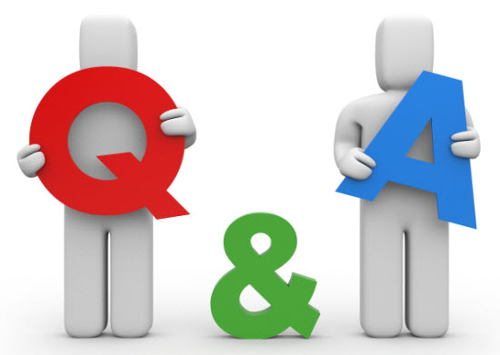

Questions & Answers
LegalWise 3.0 Team will be pleased to receive some questions in order for you to better understand our work and the capabilities of the application
LegalWise 3.0
Notes:
Summarize your contribution
Include your contact information
Ask if anyone has any questions for you.
Thank your audience
This is the end of the introduction video and the read slide

Slide 17
Thank You
LegalWise 3.0
Special Thanks
The completion of LegalWise 3.0 would not have been possible without the help and support received from previous members of LegalWise2.0, and project owner/tutor Jaime Borras. Also, we would like to mention Dr. Masoud Sadjadi and Mohsen Taheri for their valuable guidance and feedback.
Want to see more, http://legalwise3.mybluemix.net/
Notes:
Summarize your contribution
Include your contact information
Ask if anyone has any questions for you.
Thank your audience

